Slide 1
Behavioural Science brought to life
Hands-on workshop tackling a real customer pain-point
William Trump, Unconventional Wisdom

Slide 2

WHY WE’RE HERE
Human behaviour is usually the - or one of the - most important reasons for the success or failure of an initiative
And yet it’s often left to chance.
Here are a few tools that might help – then a chance to try it out for yourself.
Notes:
So what goes wrong etc
And so today we will share 3 (maybe 4 if we have time) big lessons on what we do wrong as an industry, how we need to rethink and what you can take away as a practical tips

Slide 3
ThE pitfall: we tend to oversimplify people
The big Re-think:
Human behaviour is highly complex (and context specific)
What can you do?
Ensure your idea is not just logical but also “psycho-Logical”
1
Notes:
Give some examples:
-non disclosure: it’s because people want lower prices
don’t contact people – they’re more likely to lapse
Early cancellations –it’s because of buyers’ remorse
- people need insurance- they can afford it – they like this brand: so they’ll buy insurance from this brand… NOT NECESSARILY!
Maybe that’s where I make it personal and tell the story of how predictive underwriting led me into the arms of behavioural science…
This is actually the core message of behavioural science: human behaviour is more complicated than you think. Unlike what traditional economics says – it doesn’t follow a simple model. (e.g. price curve – sometimes demand goes UP when the price goes up!). It’s context dependant for a start: look at your own behaviour – have you ever done something directly in contrast to your own behaviour somewhere else? Yes
Our business: myth busting
Or at least: testing conventional wisdom
Ask: is that the full picture?

Slide 4


The big Re-think: Human behaviour is highly complex (and context specific)
Ask yourself: Would you travel across town to save €5?
we mustn't over-simplify human behaviour. Instead, consider the role of:
It depends!
If it’s for a €15 Jacket, 68% say yes
If it’s for a €125 Jacket, only 29% say yes
(Kahneman, Tversky, 1981)
We are like this too – in so many areas of life!
➔ GOLDEN RULE: CONTEXT MATTERS
Emotion
People’s biases and heuristics
What someone’s peers are going
Environment (e.g. how options are framed)
The messenger
Brand
Fairness and expectations
➔ CRUCIAL QUESTION: HAS YOUR PRODUCT, IDEA OR CAMPAIGN TAKEN ACCOUNT OF THIS?
Notes:
We “should” have: Set preferences that remain stable across context and time.
Mental accounting $5 saving on a pen vs. a suit.
Participants are asked about buying both a jacket and a calculator. They are told that the calculator is on sale for $5 at a store across town. The price of the calculator and jacket are counterbalanced, such that people are always spending the same total amount of money (i.e., $135 if they do not drive across town versus $130 if they do).
Do I Like shouting at the top of my voice – depends on the context
DO I pay $10 for a beer… depends on the context – night out – nice bar with my wife – sure. Corner shop liquor store – definitely not.
Sounds theoretical or irrelevant until you come to real scenario: e.g. will customers be happy waiting 19 days for their claim to be paid out? IT depends! Are the expectations managed? Updated? Good reason given?
SO a golden rule is: should they do it /buy it / but will they? It depends a lot on the context!
Don’t oversimplify things – humans also act on…
Example of this going wrong: New coke as an example of getting this wrong (on the right) – superior flavour etc but backlash
For me: self ordering counters at Burrito place – yes if it’s just a transactional view of the world… but I don’t like the uncertainty of ordering – I got it wrong – it’s the opostive of the relaxing “lunch out” experience I wish…
And then an insurance example: insurance through a large furniture store – yes they need it and can afford it – AND THEY LIKE THIS BRAND – but they don’t expect to buy insurance from this brand!

Slide 5
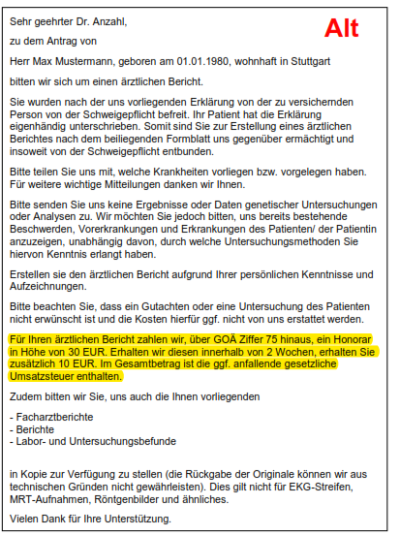
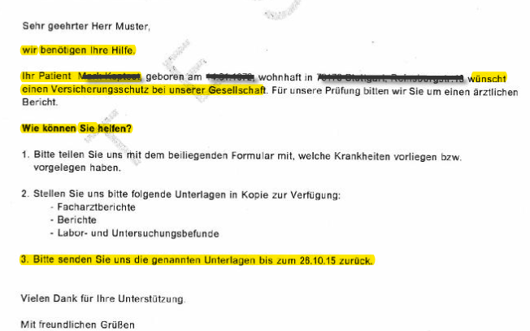
Often, MONEY IS not the answer…
Case study: Seeking to speed up return of Doctor medical forms
Standard Letter
New letter
The Challenge:
Where an application requires medical evidence from a doctor – a form is sent to the doctor
The speed of turn-around affects the likelihood of purchase – hence seeking to speed things up.
Traditional tools are not effective (more money, more info, longer time-window)
The Approach
The new letter is shorter, taps into Ego (“this is how you can help”), and asks for 7 day turn-around (previously 2 weeks) without mentioning financial payment
Notes:
But can you do it in German – actually yes…
Hello everyone and thank you for taking the time to come and listen to us.
Firstly, Will, I’d like to congratulate you for a very good presentation.
I would like to share with the rest of you what inspired me one year ago on behavioral insights. I realized the importance of effective letter writing which can change the mindset of a client.
Two-phased intervention:
Phase 1 is a follow-up phone call (July to Sept 2015)
Phase 2 kept the follow-up phone call and introduced revised offer letter (Oct – Dec 2015). Behavioural Principles tested: Priming (positive message) and Commitment
.
The letter consists of two parts: cover letter (first 2 pages) and offer which need to be signed by the client.
Typically, the agent will explain this to the customer at an appointment
A year ago I felt we had the perfect approach in writing letters. But I was wrong.
Simply because Will highlighted the following suggestions on how to shorten and to encourage a client to read and respond to on letters.
shorter time-frame
less emphasis on financial benefit (though still there)
detail etc on the next page
asking for help (Ego)
implemented in October 2015 – comparison is with same time period 2014

Slide 6


Results: a small but significant improvement Case study: Seeking to speed up return of medical forms at underwriting stage
Notes:
implemented in October 2015 – comparison is with same time period 2014
confidence at 90% for 30 days.
brings average turn-around down by 1 day
benchmark: average turn-around time is 22 days, proportion returned within 14 days is 41%

Slide 7

What can you do?
Ensure your idea is not just logical but also “psycho-Logical”
CASE STUDY
CASE STUDY
CASE STUDY
HOW TO SUCCESSFULLY INTRODUCE A VOICEBOT
HOW TO INCREASE RESPONSES TO A LETTER
HOW TO INCREASE INSURANCE SALES
LOGICAL
Efficient process launched: >90% identification success
Satisfaction (NPS) got worse
LOGICAL
People worried about scams, so we say it’s not a scam
Response rates low
LOGICAL
Tell customers about $ savings with new product
Display on outside envelope
PSYCHO-LOGICAL
Better Expectation Management (role of the voicebot, use of idle time)
PSYCHO-LOGICAL
“show don’t tell” – no mention of scam but explain justification for our contact
PSYCHO-LOGICAL
Remove message on outside of envelope, re-focus letter on how we can help you
RESULT: NPS scores recovered
RESULT: 18% relative increase in response to the letter
RESULT: 3X more inbound calls and 2.5X more sales
Notes:
Smoker status
The honesty declaration led to a 1% absolute increase: from 15% to 16% (relative uplift of 6%). Then the revised options (daily, weekly, monthly, I quit less than a year ago etc) led to 19% (that’s a 25% relative uplift!) at no cost!
Similar trial run in Indonsia, -the new response options led to an increase in disclosure but with differences between men and women: men 1% increase, women 3% increase!
Easy underwriting? Quick underwriting? What if that conveys it’s not suitable? How about: we’ll find you the right cover
From 0.5% inbound calls to 1.5% inbound calls
From 0.2% sales to 0.5% sales
#
Allianz example with doctor forms:
Where an application requires medical evidence from a doctor – a form is sent to the doctor
the speed of turn-around affects the likelihood of purchase – hence seeking to speed things up.
traditional tools are not effective (more money, more info, longer time-window)
The new letter is shorter, taps into Ego (“this is how you can help”), and asks for 7 day turn-around (previously 2 weeks) without mentioning financial payment
Results: from 6% responding within

Slide 8
The pitfall:
Businesses overestimate their customers’ interest and motivation
THE BIG Re-think: without motivation, customers are unlikely to take action
What can you do?
Diagnose the behavioural barriers to better overcome them
2
Notes:
Natural- enthusiastic – we think about this all day.
Ever since I’ve been in insurance this happens…
Most of us have probably felt the same – especially for those of us in the room whose job revolves around customer… BUT how do you tackle it? (not least because sometimes people commission customer research to “validate” their idea...)
Framework to address this? We can help you
The myth of “if we build it they will come”
Companies build things they think customers want.
Or worse still: things customers SHOULD WANT
But look at COM-B: it’s really about motivation
Make it easy –the root of my predictive days – didn’t make a difference.
And yet when someone is motivated they’ll go through all kinds of pain to achieve their goal.
Sometimes the pain also signifies something – effort heuristic – tailor made suit

Slide 9
THE BIG Re-think: without motivation, customers are very unlikely to take action
THE COM-B model of behaviour change (Michie et al. 2011)
CAPABILITY
Can this behaviour be accomplished in principle?
OPPORTUNITY
Is there sufficient opportunity for the behaviour to occur?
TARGET BEHAVIOUR
MOTIVATION
Is there sufficient motivation for the behaviour to occur?
Notes:
Step 1 Too often we assume people want something (or should want it). Behaviour change requires capability, opportunity and motivation.
The COM-B model for behavior change cites capability (C), opportunity (O), and motivation (M) as three key factors capable of changing behavior (B). Capability refers to an individual’s psychological and physical ability to participate in an activity. Opportunity refers to external factors that make a behavior possible. Lastly, motivation refers to the conscious and unconscious cognitive processes that direct and inspire behavior.⁵
This model recognizes that behavior is influenced by many factors, and that behavior changes are induced by modifying at least one of these components.⁵ The COM-B model is particularly important when considering intervention methods, as interveners need to ensure the sustainability of learned behavior. It has generally been used in a public health setting.
The COM-B Model for Behavior Change - The Decision Lab source

Slide 10
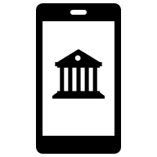
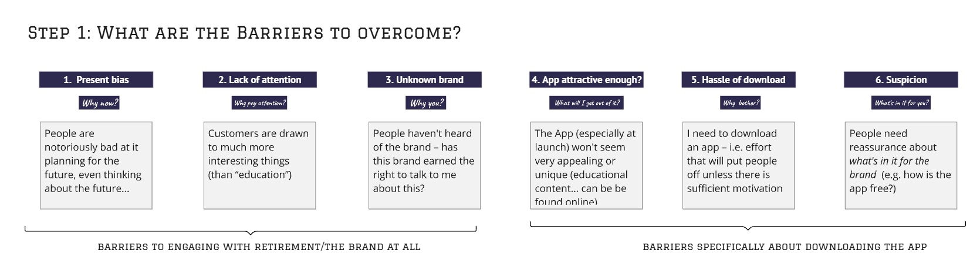
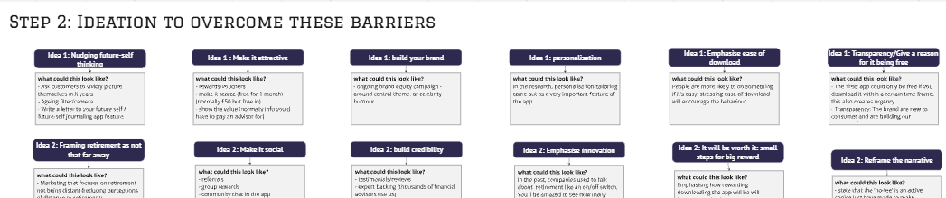
What can you do? Diagnose the behavioural barriers to better overcome them
Case Study: WHAT ARE THE BARRIERS TO DOWNLOADING A RETIREMENT PLANNING APP?
Notes:
Not particularly popular process to go through – brainstorming all the ways someone wouldn’t get round to doing what you
BUT the ideation phase is all the more effective when you’ve identified the barriers

Slide 11
Reason for optimism: Dialling up motivation can sometimes be as little as a word, a question or a sentence
CASE STUDY
CASE STUDY
CASE STUDY
USE OF CUSTOMER PORTAL
DOCTORS’ USE OF INSURER TOOL
HEALTH INSURANCE RETENTION
FROM
“Register” to our portal
High perceived effort
FROM
“Use our Interactive Tool” to provide health information
Possible backfiring message
FROM
Explaining benefits when customers call up to ask about price increase
TO:
“Activate” your account
Low perceived effort
TO:
Choose between the “Fast-Track” or Manual process
TO
Get the customer talking: with the question: what matters most to you with your health insurance?”
RESULT: 29% relative uplift in activations
RESULT: 14% relative uplift in use of the interactive process
RESULT: more engaging conversations and improvement in cancellations
Notes:
Underwriting tool – went from 70% to 80%

Slide 12

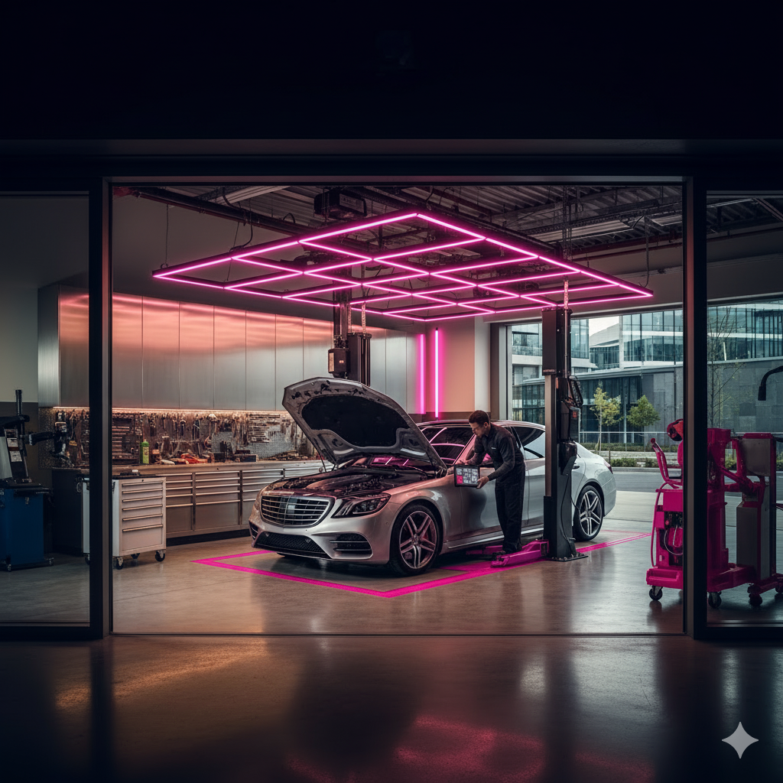
OVER TO YOU!
Hands on Case STUDY: Claims steering in motor insurance
A large motor insurer handles 30,000+ claims each year. Their goal was to encourage more customers, at the point of claim, to use one of their partner garages for repairs.
This was beneficial for both sides:
For the insurer → lower claims costs through pre-negotiated repair rates
For the customers → lower excess (CHF 200 cheaper), and added convenience (pickup & return, free car cleaning)
Yet despite these benefits, only a small proportion of claimants chose partner garages. (<30%)
WHAT MIGHT BE THE BARRIERS THAT PREVENT A CUSTOMER FROM USING APPROVED GARAGES?
Notes:
Not particularly popular process to go through – brainstorming all the ways someone wouldn’t get round to doing what you
BUT the ideation phase is all the more effective when you’ve identified the barriers

Slide 13
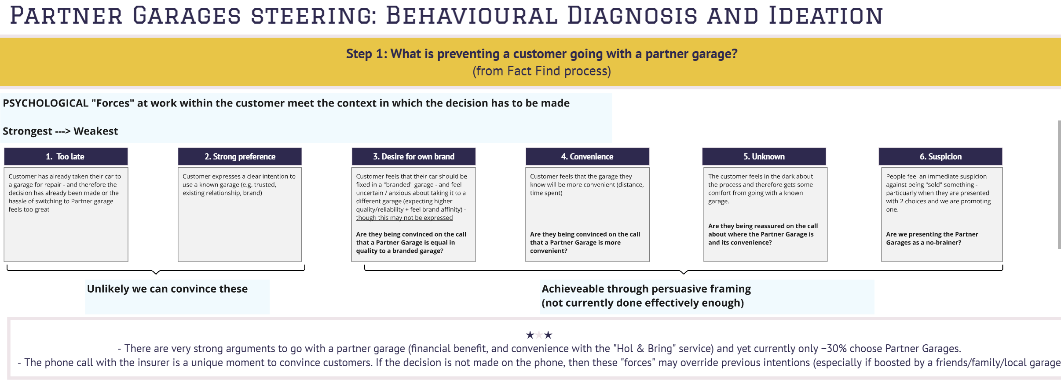
CASE STUDY: WHAT ARE THE BARRIERS TO USING APPROVED GARAGES?
Step 1: Diagnosis
By listening to claims calls and interviewing key stakeholders, we identified the behavioural and contextual barriers preventing customers from choosing a partner garage at claim stage.

Slide 14
CASE STUDY: WHAT ARE THE BARRIERS TO USING APPROVED GARAGES?
Step 1: Diagnosis
By listening to claims calls and interviewing key stakeholders, we identified the behavioural and contextual barriers preventing customers from choosing a partner garage at claim stage.
UNCERTAINTY
INERTIA
POOR FRAMING
Going to a different garage felt unfamiliar; they didn’t understand the process
They had a clear intention to use a particular garage (due to existing relationships, familiarity, and trust)
When the benefits of partner garages were not explained clearly, customers defaulted to what is familiar

Slide 15
OVER TO YOU!
Hands on Case STUDY: Claims steering in motor insurance
STEP 2:SOLUTIONS
WHAT MIGHT BE SOME SOLUTIONS THAT WOULD OVERCOME THESE BARRIERS?
Notes:
Not particularly popular process to go through – brainstorming all the ways someone wouldn’t get round to doing what you
BUT the ideation phase is all the more effective when you’ve identified the barriers

Slide 16
CASE STUDY: Claims steering in motor insurance
Step 2: Behavioural Solutions
Two part programme:
Equip the agents (toolkit)
Motivate the agents (incentives)
We built a toolkit of persuasive techniques, grounded in behavioural science, for agents to use on calls.
This was supplemented by a ‘training that sticks’ with the claim handlers, including role play and call listening
➔ RESULT: 31% uplift in claims steering, saving $1.2m in claim cost for the insurer
OUR PERSUASIVE TOOLKIT
Utilise defaults → frame partner garages as the standard/normal repair process
Harness consistency → remind customers that the policy they chose includes partner garage repairs
Harness loss aversion → highlight the financial cost of not using a partner garage
Make the benefits salient → clearly state savings and convenience
Show empathy → build rapport so customers are more open to recommendations
Build trust & credibility → counter suspicion with proof-points (e.g. “used by thousands of customers every year”)

Slide 17
YOUR BEHAVIOURAL PAIN-POINTS?
CONNECT ON LINKEDIN
William Trump, Unconventional Wisdom
Notes:
So what goes wrong etc
And so today we will share 3 (maybe 4 if we have time) big lessons on what we do wrong as an industry, how we need to rethink and what you can take away as a practical tips

Slide 18
The pitfall:
Businesses assume everything can be digitalised
The big Re-think: familiarity and uncertainty will affect digital uptake
What can you do?
The Stakes Spectrum helps you decide if/when (and how) digitalisation could work
3
Notes:
CASE STUDY:
new (superior) online COMPARISON tool: HIGHER traffic, LOWER conversion RATE. WHY?
Why? there is more going on than just a transaction that can be reduced to an online journey:
Reassurance
Same can be said for neobanks for example
Cheques and payslips -

Slide 19







THE BIG RETHINK: familiarity and uncertainty
will affect digital USE & uptake
What can you do? The Stakes Spectrum helps you decide if/when (and how) digitalisation could work
Some tasks feel “HIGH STAKES”:
High complexity
Unfamiliar
Uncertainty / Risk
More emotional
➔ Harder to achieve digital adoption
Some tasks feel “LOW STAKES”:
Straightforward
Familiar
Low risk
Less emotional
➔ Easier to achieve digital adoption
AT THIS END: Opportunity to delight customers if you help them with their issue
AT THIS END: Opportunity to dismay customers if expectations not met
Techniques that move a task toward easier end:
If it’s been done previously (successfully!)
Other people’s feedback
“Reassurance” hacks (e.g. free returns)
Option to revert to non-digital path
Notes:
Buying a book online – easy now
Booking a flight/ferry – I remember the first time I did this online with my dad – nervous the first time… went well and then repeated…
Notice I didn’t say: harder to digitise – these things may be available online but doesn’t mean people want to do it
Discuss: what is your business currently exploring / trying to launch online and where is it on the spectrum?
Travel insurance vs. life insurance?
Not just about buying but also interactions/events – e.g. car accident.
Charlotte story on spotify getting hacked – panic, reassurance, from tragic to magic moment

Slide 20

Re-think: without motivation, customers are unlikely to take action
Case study: wearable device & insurance discounts
Proposition: customers offered a fitness watch (either free or subsidized) when buying life insurance. A 10% discount is applied on your policy if you achieve health goals over a 6 month period
Result:
  For the subsidized watch (cost $250): 1.5% of customers said yes and 60% of them joined the programme (overall 0.8%)
  For the free watches, 35% said yes but only 35% of them joined the programme – overall 12%
Follow-up: sent out free watch to a sample of customers, but only 20% activated their watch in the programme
Notes:
Make the point that the focus was on Capability and Opportunity assuming that Motivation was there- when it wasn’t… struggled
Be aware of the risks of distrust / messenger effect (e.g. people look through your actions to your intentions) – in this project it got in the way of use –and the JUST research also showed a distrust
Plough back the fees for our products back into make services free for everyone.

Slide 21
The pitfall:
Businesses assume they know what customers want (and so do they!)
The Big Rethink:
There’s some things customers can tell you about – and some things they can’t
What you can do: listen to customers and observe their behaviour
4

Slide 22


The big Re-think:
There are some things customers can tell you about – and some things they can’t
CONSIDER What customers can tell you about
CONSIDER what customers can’t tell you about
Don’t use research to support existing theories
Then: ASK THEM
SEARCH FOR ILLUMINATION
Then: OBSERVE their behaviour

Slide 23
WHat have we covered today
1
2
3
4
THE PITFALL:
Businesses tend to
oversimplify people
THE BIG RE-THINK:
Human behaviour is
highly complex (and context specific)
WHAT YOU CAN DO
Ensure your idea is not just logical but also “psycho-Logical”
THE PITFALL:
Businesses overestimate their customers’ interest and motivation
THE BIG RETHINK:
without motivation, customers are unlikely to take action
WHAT YOU CAN DO
Diagnose the behavioural barriers to better overcome them
THE PITFALL:
Businesses assume everything can be digitalised
THE BIG RE-THINK:
familiarity and uncertainty will affect digital uptake
WHAT YOU CAN DO
The Stakes Spectrum helps you decide if/when (and how) digitalisation could work
THE PITFALL:
Businesses assume they know what customers want (and so do they!)
THE BIG RE-THINK:
Some things customers can tell you about – some things they can’t
WHAT YOU CAN DO Truly listen to customers and observe their behaviour

Slide 24
THE FINAL WORD: Human behaviour is complex, and context-specific, so test everything
Results
Case study: how to nudge (typically older) customers to switch to Direct Debit?
We tested multiple versions
Control: the standard, traditional message
Salience: a re-written letter that drew attention to hassle of paying by cheque & benefits of switching
Conditional incentive: the traditional message, but offering a £10 voucher when they switch.
Unconditional incentive: traditional message, but with a £5 voucher included in the letter (asks customers to "return the favour" by switching)
Active Choice: we re-framed the message in a way that "imposed" a response on customers (“We need to hear from you, updating us on your payment preference, whether you wish to switch or not”)
Notes:
1 word (activate vs. register ; fast track instead of interactive) – one sentence (here – explained), one headline (gone aways – 5 times more people respond) one questions
Environment: seeking to contact 75+ at new address to verify details
Ideas: salience (ask a relevant question & draw attention to “why” should take action)
Study design: send out 200 of each letter in parallel in Dec – to otherwise identical customers - and track response
Results :
five-fold increase in response rate from 6.5% to 35.5%
Now been rolled out to subsequent 1489 customers, and achieved 37.4% response rate
Money is expensive way to change behaviour: MyAviva vouchers: it does create an uplift but it’s expensive and also
CREATE / HARNESS MOTIVATION NOT BY TALKING AT THE CUSTOMER BUT THROUGH THE RIGHT OPEN-ENDED QUESTION
We have helped an Irish Health insurer radically improve their renewal call flow away from an “agent-led” approach (describing the plan and benefits) to an “customer-led” approach, harnessing the key question: can you tell me what’s most important for you?
➔ Calls are shorter (not longer as feared) and retention rates have increased.
In a separate project, we found that life insurers achieve highest sales when they start the conversation with the question: What got you thinking about life insurance?

Slide 25
SUMMARY
Behavioural Science gives you a more realistic framework for understanding human behaviour
And it gives you a toolkit to translate this insights into strategies that achieve a better result: the nudges
So whenever you face a customer behaviour challenge, behavioural science can probably help and achieve an uplift

